Slide 1
Fundamental Analysis & Stock Price Estimation
Team “Millionaires”:
Bingqing Li, Kerui Chen, Yuejia Feng, Tingyi Hung, Fan Hong
May 9th, 2019
Advanced Mining & Web Analysis

Slide 2
Agenda
Introduction
Fundamental Analysis
——Linear Regression
Stock Price Estimation
——Time Series
ARIMA
LSTM
Business Insights

Slide 3
Introduction
Objectives and Dataset

Slide 4
Introduction
Project Objectives
Dataset
Build time series models for New York Stock Exchange to predict tomorrow’s stock price in a continuous format
Plot a trendline for future understanding
Extract business insights from the modeling analysis
Four data files from New York Stock Exchange Kaggle
Stock Price data
Company’s yearly financial data

Slide 5
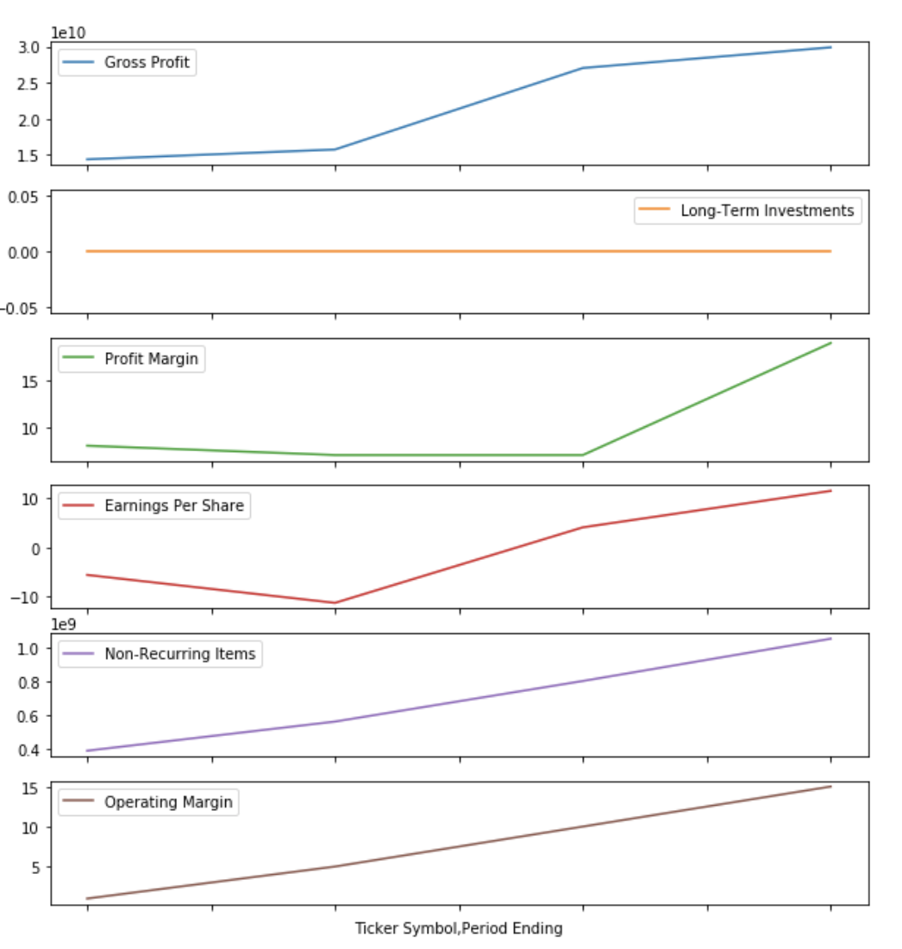
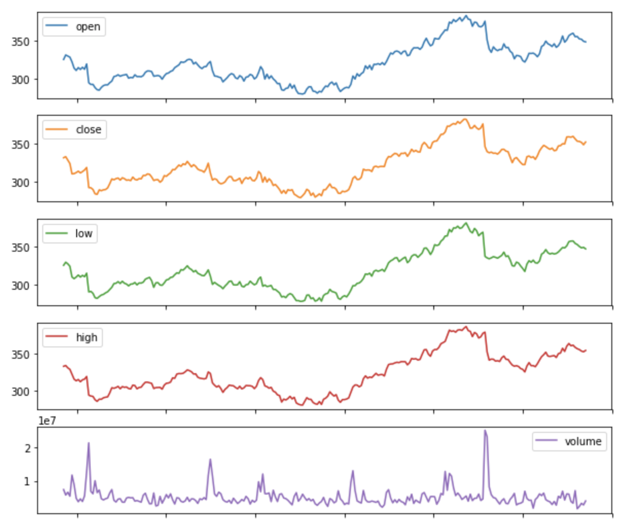
Data Visualizations
AAL from 2012 to 2015
GOOG 2012

Slide 6
Fundamental Analysis
Linear Regression Model

Slide 7
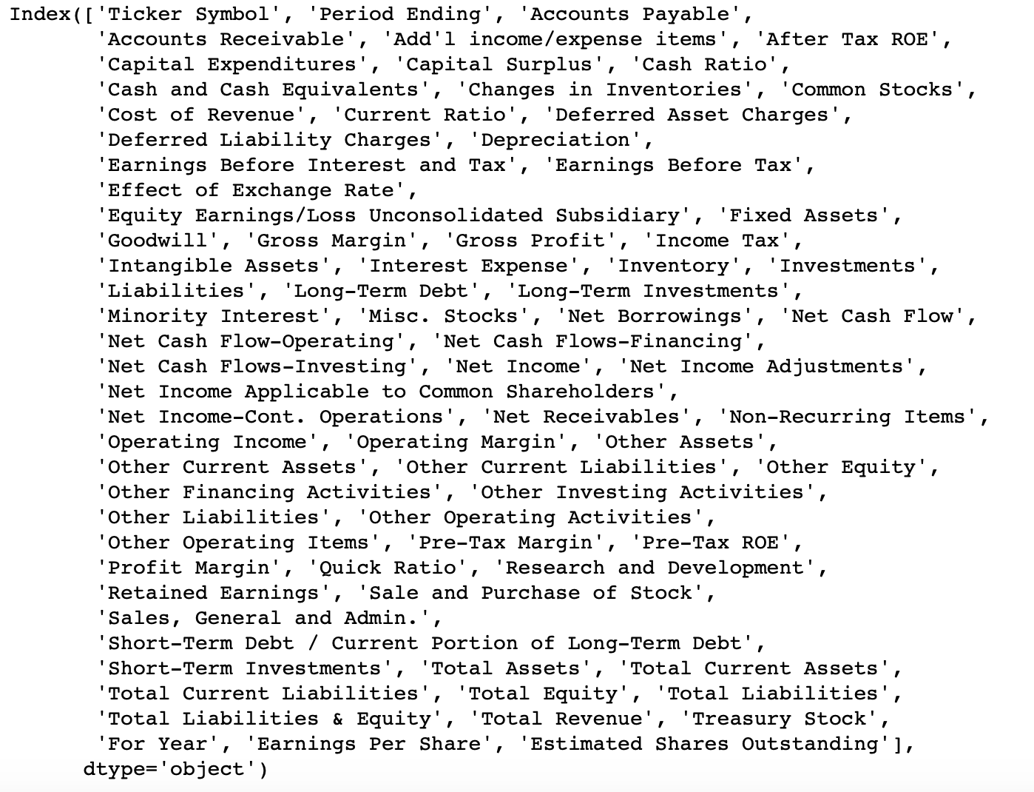
Our Data - Additional Company Data
Company’ financial data in yearly basis
Time period: 2010-2016

Slide 8
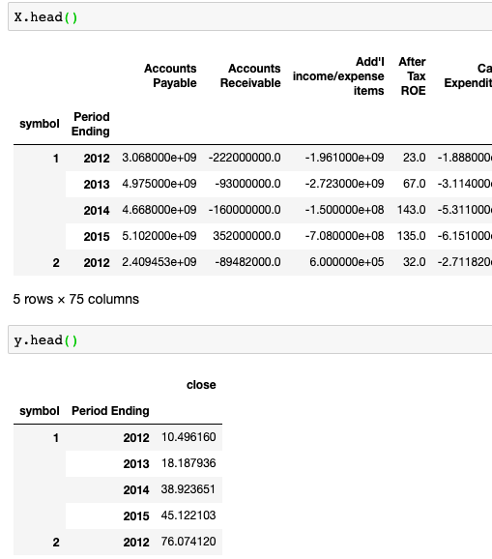
Linear Regression(OLS)
Data processing
X~Fundamental data
y~Average stock price per/Y
Check multicollinearity
Train Linear regression model
Predict and plot the result

Slide 9
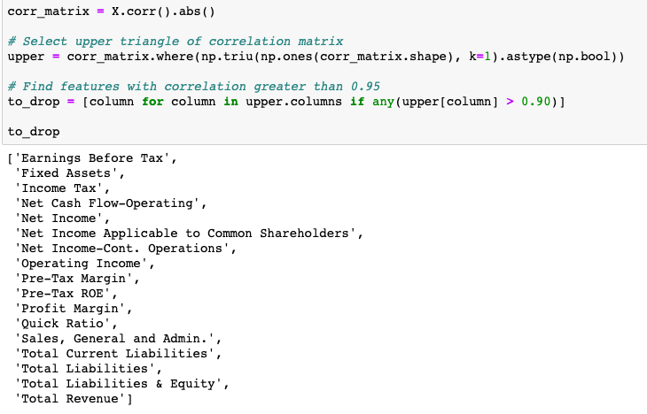
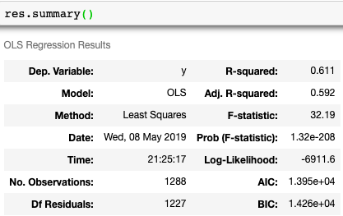
Linear Regression(OLS)

Slide 10
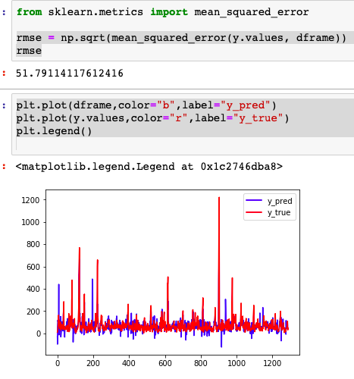
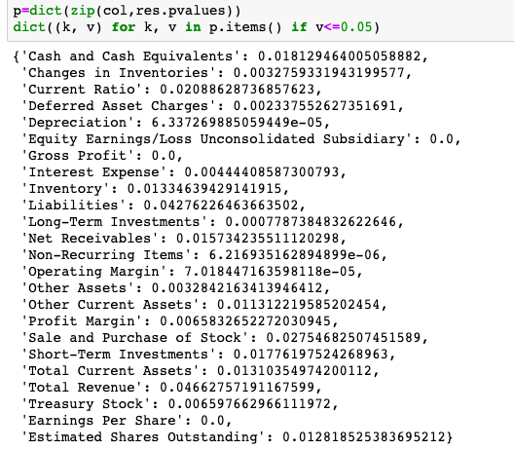
Linear Regression(OLS)

Slide 11
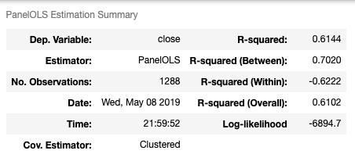
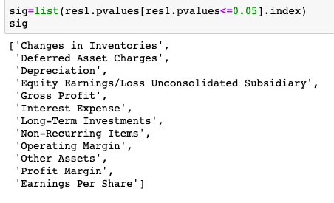
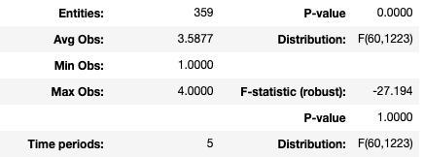
Linear Regression( PanelOLS )
When training the Panel OLS model, it will cluster by time and entities automatically

Slide 12
Stock Price Estimation
Time Series Model

Slide 13
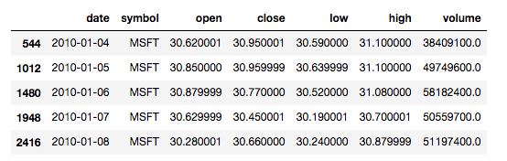
Our Data - Price
Time series data of prices for each company from 2010 to 2016 (years may be different)
1762 data points
Variables:
open: starting price
close: final price
low: minimum price
high: maximum price
volume: the number of shares bought or sold in the day

Slide 14
Auto-Arima
Model Explanation
Automatically find the best combination of Arima model based on information criterion which estimates the quality of the model
Parameters:
p: The order of the auto-regressive model, which will incorporates past values.
d: The degree of differencing.
q: The order of the moving average model.
P, D & Q: Describe the same associations as p,d, and q, but correspond with the seasonal components of the model.
m: The number of observations per seasonal cycle. m = 12 (for monthly data suggests a yearly seasonal cycle)
Using AIC and BIC to test model’s quality

Slide 15
Auto-Arima
Steps:
Load and preprocess dataset
Choose Microsoft (symbol: MSFT) as target company
Use “close” data as target variable to predict on
Drop the other columns
Split the univariate series into train and test sets
Fit the model
Make predictions on the test set
Calculate RMSE
Notes:
Fit ARIMA: order=(1, 1, 1) seasonal_order=(0, 1, 1, 12); AIC=1755.597, BIC=1781.479, Fit time=10.635 seconds
Fit ARIMA: order=(0, 1, 0) seasonal_order=(0, 1, 0, 12); AIC=2590.232, BIC=2600.585, Fit time=0.755 seconds
Fit ARIMA: order=(1, 1, 0) seasonal_order=(1, 1, 0, 12); AIC=2212.685, BIC=2233.390, Fit time=3.367 seconds
Fit ARIMA: order=(0, 1, 1) seasonal_order=(0, 1, 1, 12); AIC=1753.477, BIC=1774.182, Fit time=8.552 seconds
Fit ARIMA: order=(0, 1, 1) seasonal_order=(1, 1, 1, 12); AIC=1755.417, BIC=1781.298, Fit time=10.723 seconds
Fit ARIMA: order=(0, 1, 1) seasonal_order=(0, 1, 0, 12); AIC=2591.909, BIC=2607.438, Fit time=0.733 seconds
Fit ARIMA: order=(0, 1, 1) seasonal_order=(0, 1, 2, 12); AIC=1755.418, BIC=1781.299, Fit time=35.877 seconds
Fit ARIMA: order=(0, 1, 1) seasonal_order=(1, 1, 2, 12); AIC=1757.119, BIC=1788.176, Fit time=47.112 seconds
Fit ARIMA: order=(0, 1, 0) seasonal_order=(0, 1, 1, 12); AIC=1752.079, BIC=1767.608, Fit time=14.162 seconds
Fit ARIMA: order=(0, 1, 0) seasonal_order=(1, 1, 1, 12); AIC=1754.013, BIC=1774.718, Fit time=15.726 seconds
Fit ARIMA: order=(0, 1, 0) seasonal_order=(0, 1, 2, 12); AIC=1754.015, BIC=1774.720, Fit time=41.746 seconds
Fit ARIMA: order=(0, 1, 0) seasonal_order=(1, 1, 2, 12); AIC=1755.688, BIC=1781.569, Fit time=46.358 seconds
Fit ARIMA: order=(1, 1, 0) seasonal_order=(0, 1, 1, 12); AIC=1753.472, BIC=1774.177, Fit time=37.054 seconds

Slide 16
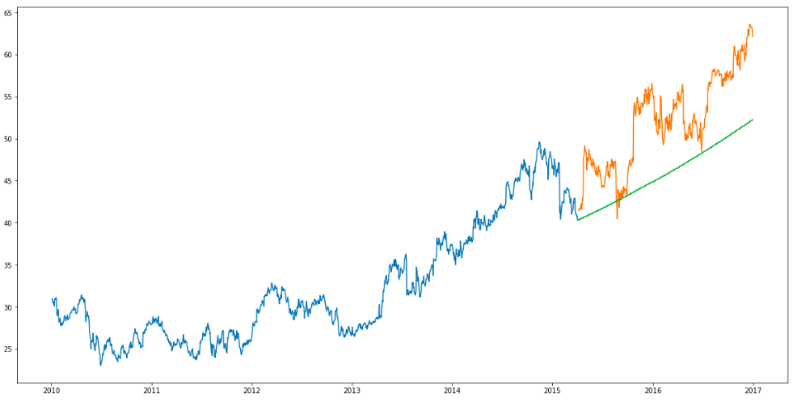
Results
RMSE on test set:
6.858

Slide 17
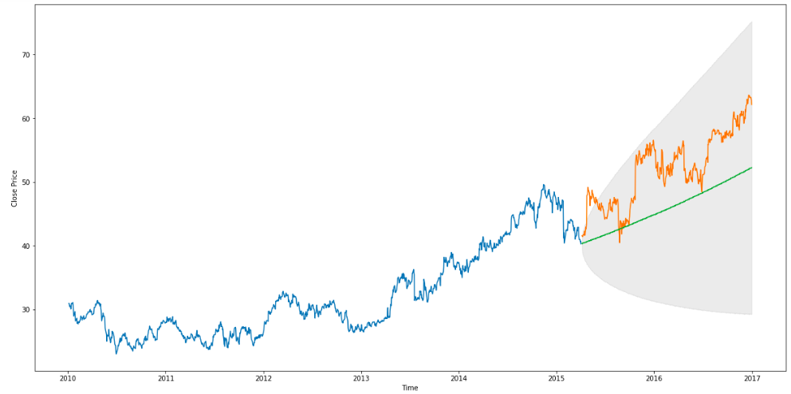
Uncertainty of Predictions
Our results lie in the 95% Confidence Interval.
As time increases, the prediction becomes more uncertain, so the area of Confidence Interval becomes wider.
Notes:
95% confidence interval suggests that there is a high likelihood that the real observation will be within the range.

Slide 18
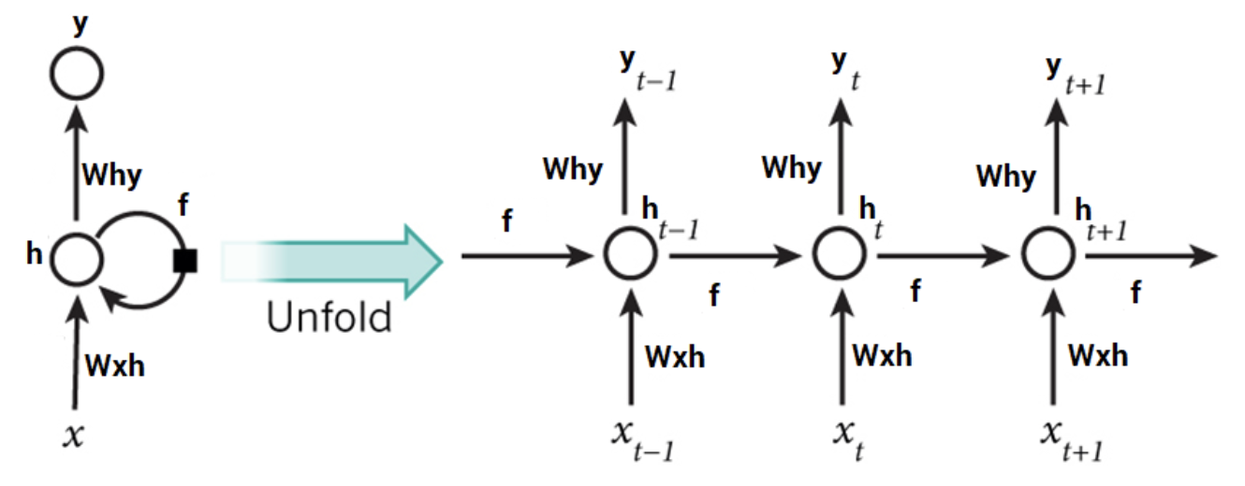
Quick Recap of RNN
Every prediction at time t (h_{t}) is dependent on all previous predictions and the information learned from them
RNNs are great when it comes to short contexts
Fail to understand the context behind an input
Reason: Vanishing Gradient
Notes:
but in order to be able to build a story and remember it, we need our models to be able to understand and remember the context behind the sequences
short term dependency
Something that was said long before, cannot be recalled when making predictions in the present.

Slide 19
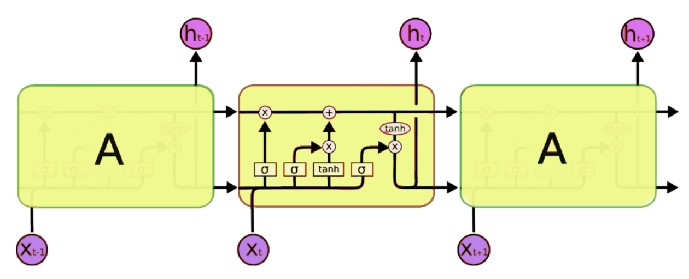
LSTM
Improvement over RNN
Effective on sequence prediction
Architecture of LSTM:
The forget gate: It removes the information that is no longer required by the model
The input gate: The input gate adds information to the cell state
The output gate: Output Gate at LSTM selects the information to be shown as output
Notes:
Long short Term Memory networks
store past information that is important, and forget the information that is not
With LSTMs, the information flows through a mechanism known as cell states. This way, LSTMs can selectively remember or forget things. The information at a particular cell state has three different dependencies.
property of selectively remembering patterns for long durations of time.
conventional feed-forward neural networks, all test cases are considered to be independent. there is no consideration for the stock prices on the previous days.

Slide 20
LSTM in Time Series Prediction
Import libraries and dataset, and pick 1 firm: Agilent Technologies
Split into dataset_train and dataset_test
Data structure with 60 timesteps and 1 output
Importing the Keras libraries and packages
Initialising the RNN: Sequential model
Adding the 1st to 4th LSTM layer (50 units) and some Dropout regularisation & the output layer
Compiling the RNN (Optimizer: Adam & Loss: MSE)
Fitting the RNN to the Training set
Getting the real stock price of 2017
Getting the predicted stock price of 2017
Visualising the results
Data Preprocessing
Building the RNN
Making predictions
Visualization
Notes:
Import libraries and dataset, and pick 1 firm
Split into dataset_train and dataset_test
Feature scaling
Data structure with 60 timesteps and 1 output
Reshaping Keras (batchsize, time step, input-dimention)
Importing the Keras libraries and packages
Initialising the RNN
Adding the 1st to 4th LSTM layer and some Dropout regularisation
Adding the output layer
Compiling the RNN
Fitting the RNN to the Training set
Getting the real stock price of 2017
Getting the predicted stock price of 2017
Visualising the results

Slide 21
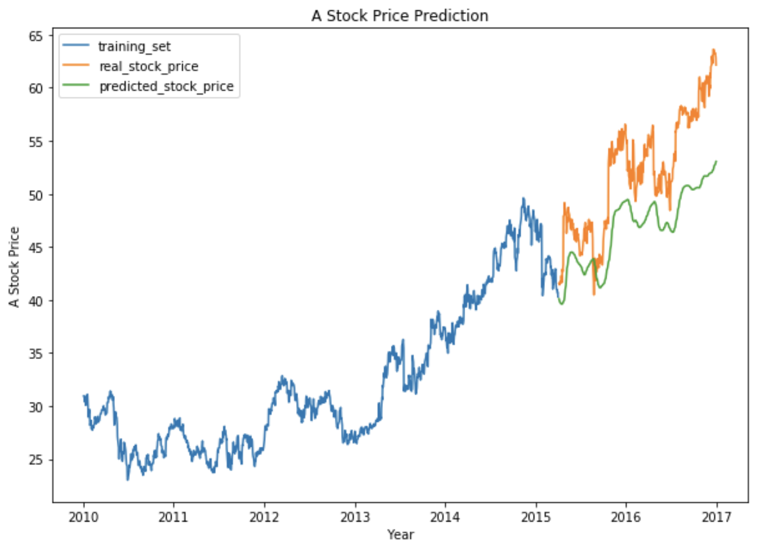
Results
RMSE on test set:
5.85

Slide 22
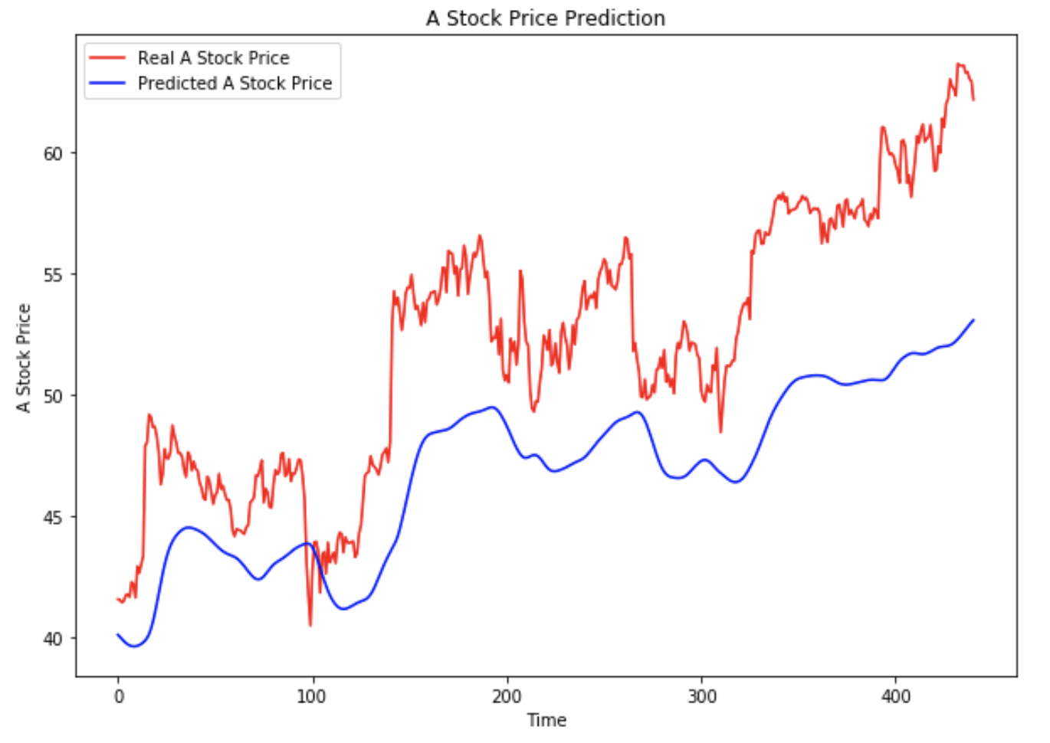
Results

Slide 23
Model Evaluation: Arima VS LSTM
RMSE: Arima vs LSTM
T-test (Further Step)
Notes:
R-squared - not suitable for lstm
ARIMA-LSTM Hybrid Model
Using the evaluation measures RMSE and MAE together with a t-test the results show that the difference between the LSTM and ARIMA model is not of statistical significance in the scenario of predicting one day ahead. However when predicting seven days ahead, the results show that there is a statistical significance in the difference indicating that the LSTM model has higher accuracy

Slide 24
Business Insights

Slide 25
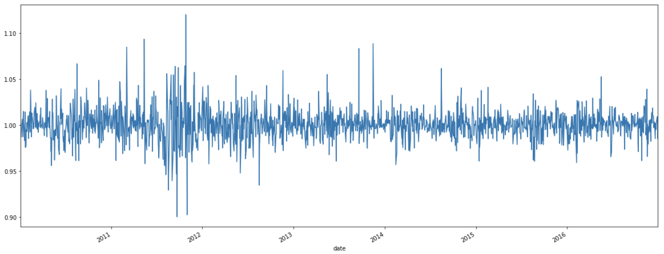
Insights: Percent Change
Notes:
High stock price

Slide 26
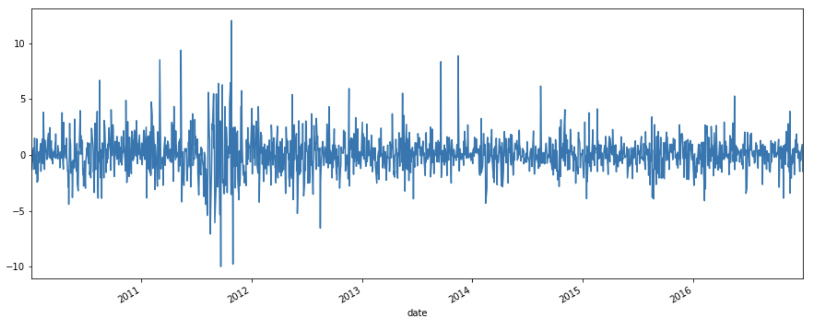
Insights: Stock Return
Notes:
http://financeformulas.net/Total-Stock-Return.html
High stock price

Slide 27
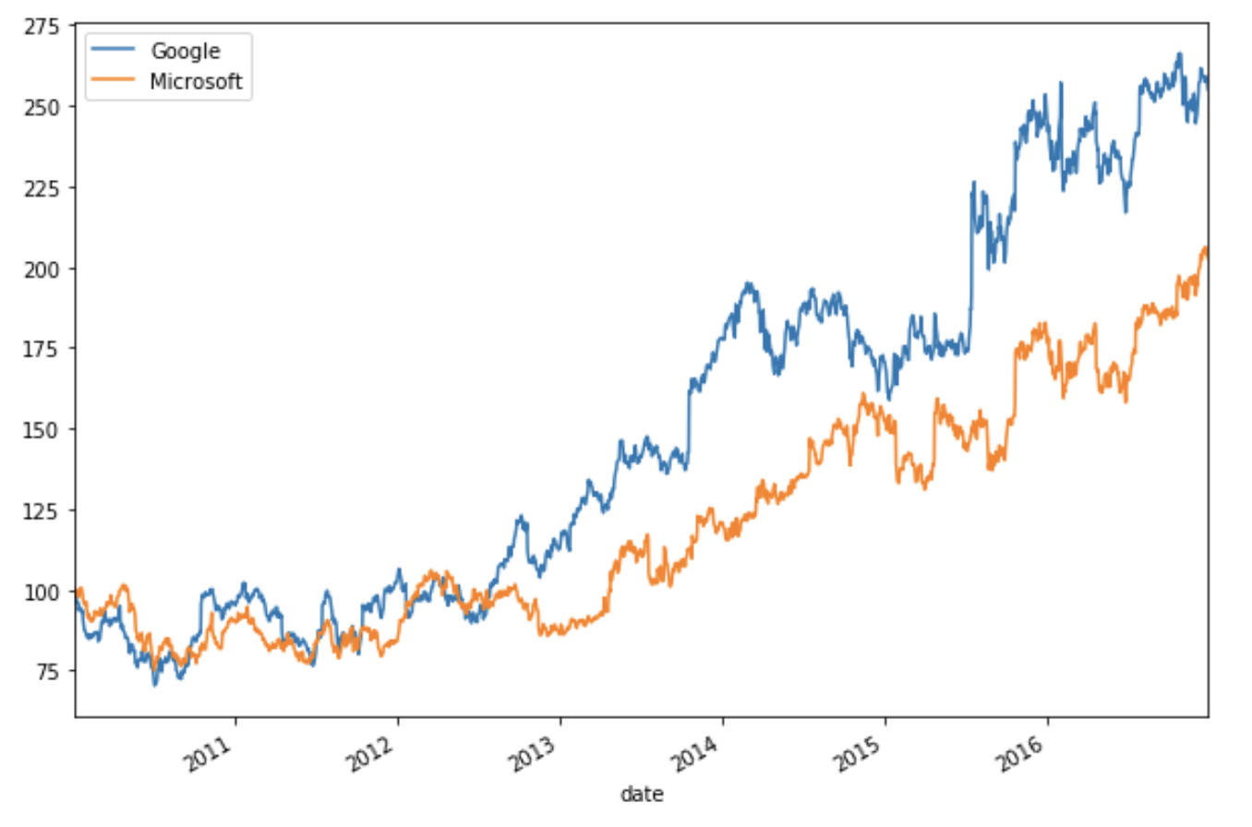
Insights: Compare different companies
Clearly see how Google outperforms Microsoft
Normalize the data by dividing each time series element of all time series by the first element
Start from 100
Notes:
High stock price

Slide 28
OLS Insights
Based on the significance level of variables (P value) and coefficients (Beta),
it turns out:
Positive Influence
Negative Influence
Gross Profit
Long-Term Investments
Profit Margin
Earnings Per Share
Non-Recurring Items
Operating Margin
Deferred Asset Charges
Interest Expense
Cash and Cash Equivalents
Inventory
Total Current Assets

Slide 29
Questions
Answers

Slide 30

Thank you
Notes:
https://pixabay.com/en/new-york-city-tribute-in-lights-sky-78181/

